Slide 1

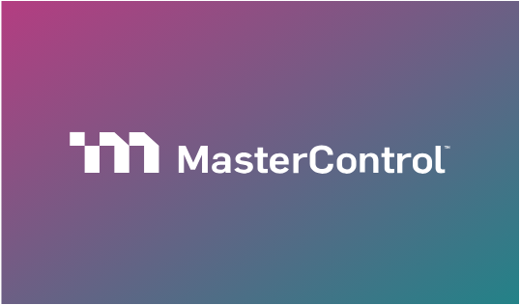

Master Control Lead Scoring and Conversion Optimization
Predicting high-value leads to boost sales efficiency
By: Astha K C
Max Ridgeway
Thomas Beck

Slide 2







Table of Contents
01
02
03
Business Problem and Opportunity
Data Foundation and Challenges
Features
Perf gap & sales issues
Dataset traits & issues
Business signals & findings
04
05
Strategic roadmap for transforming CRM data into actionable sales intelligence
Modeling and Evaluation
Impact
Model choice & explain
ROI & action plan

Slide 3




Product Portfolio Performance Gap
Mx (Manufacturing)
12.7% conversion
7% gap
Revenue loss
Qx (Quality)
19.7% conversion
The 7-percentage-point conversion gap between Mx and Qx products represents a significant untapped revenue opportunity, signaling the need for targeted intervention in Mx lead prioritization strategy.

Slide 4







Sales efficiency impact
The Problem
SDRs operate with limited time and lack a data-driven system to prioritize which leads to contact first, resulting in inefficient resource allocation.
Cost Reality
Each sales call costs $50 in SDR time and resources, while each successful conversion generates $6,000 in value.
Revenue Impact
The 7% conversion gap between Mx and Qx translates directly to substantial lost revenue and missed growth opportunities.
Strategic Need
Intelligent lead prioritization is essential to maximize ROI by directing SDR efforts toward highest-probability conversion opportunities.

Slide 5






Project Objective
Predictive Model
Build a machine learning lead scoring model to identify and rank high-probability conversion opportunities using historical CRM data.
Data-Driven Ranking
Generate probability scores for all leads and rank them by conversion likelihood, enabling systematic prioritization.
ROI Maximization
Optimize sales team efficiency and revenue impact by directing SDR outreach to the right leads at the right time.

Slide 6









Dataset Overview & Key Traits
Scale
Imbalance
Conversion
Performance Gap
Approximately 16,800 leads analyzed across Mx and Qx product lines
Severe class imbalance with ~85% non-converted leads requiring specialized modeling techniques
Overall conversion rate of 18% across the entire dataset
Distinct 7% performance gap between Mx (12.7%) and Qx (19.7%) segments

Slide 7
Key Technical Challenges
Severe Class Imbalance
Business Explainability Requirement
85% non-converted leads required SMOTE, class weighting, and threshold optimization techniques
Sales adoption required SHAP values and interpretable feature importance for actionable insights
Categorical Feature Dominance
CRISP-DM Framework
Limited numerical data necessitated advanced encoding strategies and feature interaction engineering
Structured methodology ensured business understanding, data preparation, modeling, and deployment alignment
Free-Text Job Title Complexity
~4,000 unique job titles demanded NLP embeddings and semantic role classification algorithms

Slide 8
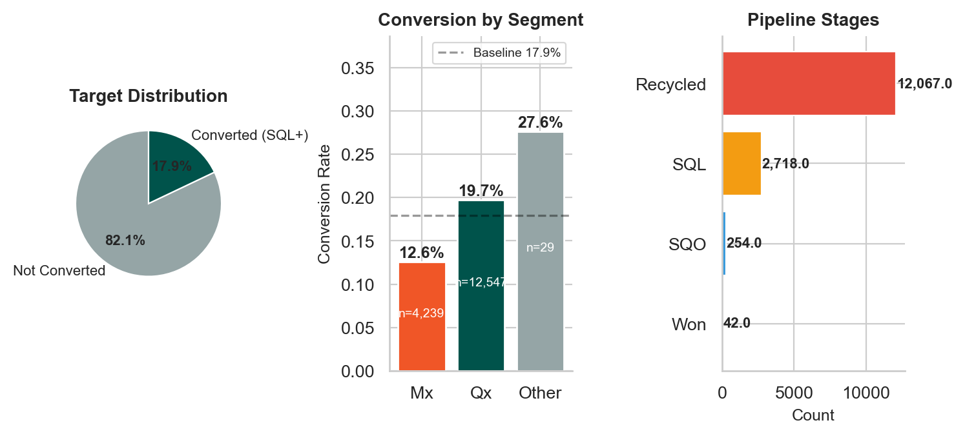
Class Imbalance in the Data

Slide 9
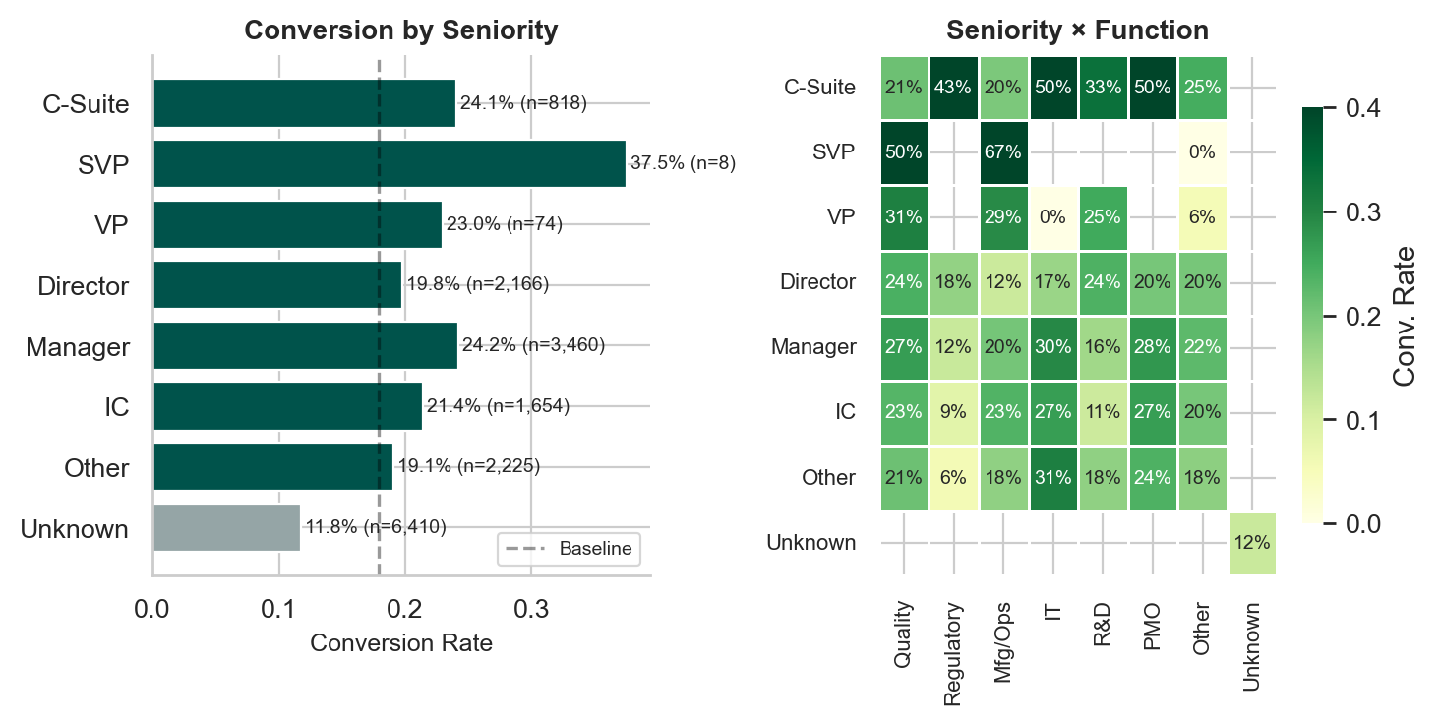
Free-Text Job Title Complexity

Slide 10
Core Feature Engineering Strategy
Intent Strength
Content downloads, demo requests, webinar attendance signal buying readiness
Channel Efficiency
Premium channels (webinars, direct outreach) vs. low-value channels (organic search)
Firmographics
Company size and industry segmentation identify ideal customer profiles
Role Seniority
Decision-making authority indicators (VP, Director, C-suite) predict conversion
Behavioral Recency
Time-based engagement signals capture momentum and buying cycle timing
Key Outcome
Strong separation achieved between converted and non-converted lead cohorts

Slide 11






Advanced Feature Engineering
Buying Committee Activity
Cross-Product Interest
Executive Momentum
Multiple stakeholders from same organization signal organizational buying intent
Mx + Qx combined engagement indicates broader solution needs and higher deal value
Seniority × intent interaction captures executive-level buying signals and urgency
Regulatory Urgency Scoring
Semantic NLP Analysis
Industry compliance pressure indicators (Pharma, Biotech, Medical Device) predict quality system needs
Job title embeddings and role classification extract decision-making authority from unstructured text
These advanced features significantly improved model discrimination power

Slide 12







Exploratory Data Analysis: Key Findings
Channels
Senior Role Impact
Functions
Mx Performance
Premium channels (webinars, demos) convert 3x higher than low-value channels
VP and Director roles convert at 2x the rate of individual contributors
Quality and Regulatory functions show 25% higher conversion than other departments
Mx gap driven by targeting misalignment, not product quality issues

Slide 13






Modeling Approach & Selection
Logistic Regression
Baseline model providing interpretability and coefficient-based feature importance
Random Forest
Non-linear pattern detection with feature interaction discovery
Gradient Boosting Suite
XGBoost, LightGBM for advanced tree-based sequential error correction
CatBoost
Optimized for categorical features with built-in encoding strategies
Ensemble Techniques
Stacking and voting methods combined model strengths for optimal performance

Slide 14
Model Evaluation Strategy
Primary Metric
AUC-ROC measures ranking performance and lead prioritization effectiveness
Metrics
Precision, Recall, F1-score, and calibration analysis ensure balanced performance
Generalize
Rigorous test set validation prevents overfitting and ensures real-world applicability
Business Fit
Prioritized actionable insights over raw accuracy for sales team adoption
Cross-Validation
Stratified k-fold validation ensures robust performance estimation across data splits

Slide 15
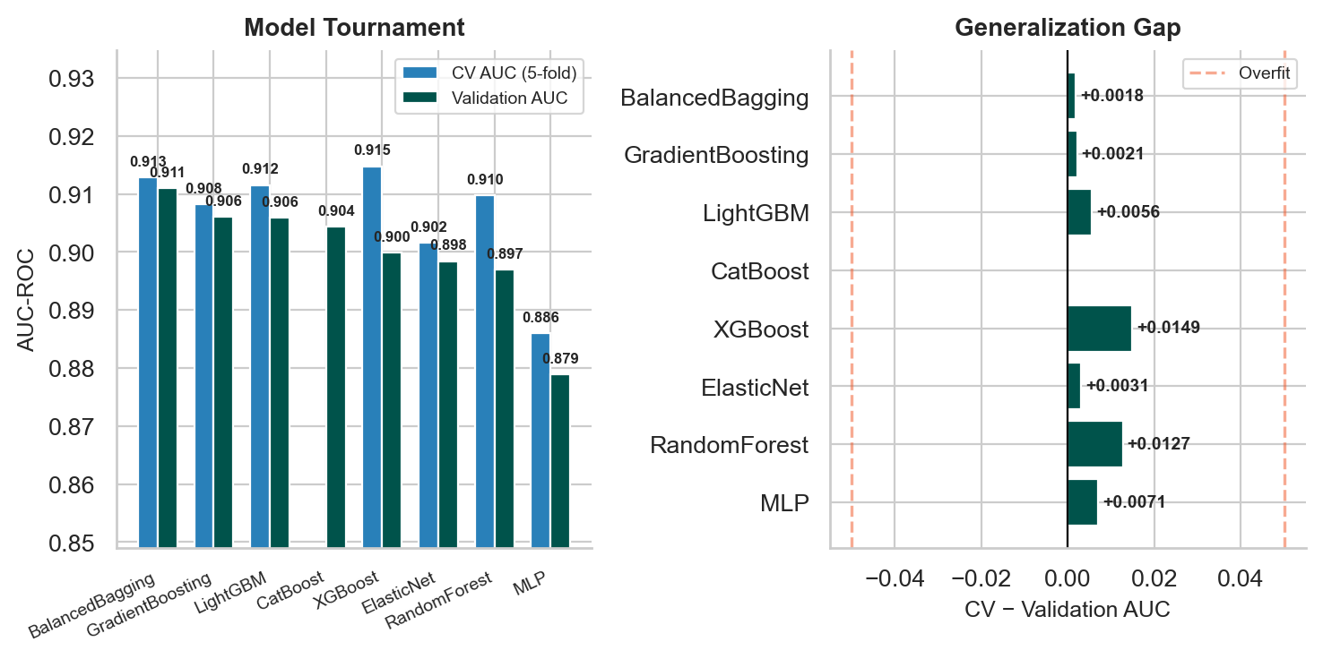
Model Evaluation Strategy Visualization Part 1

Slide 16
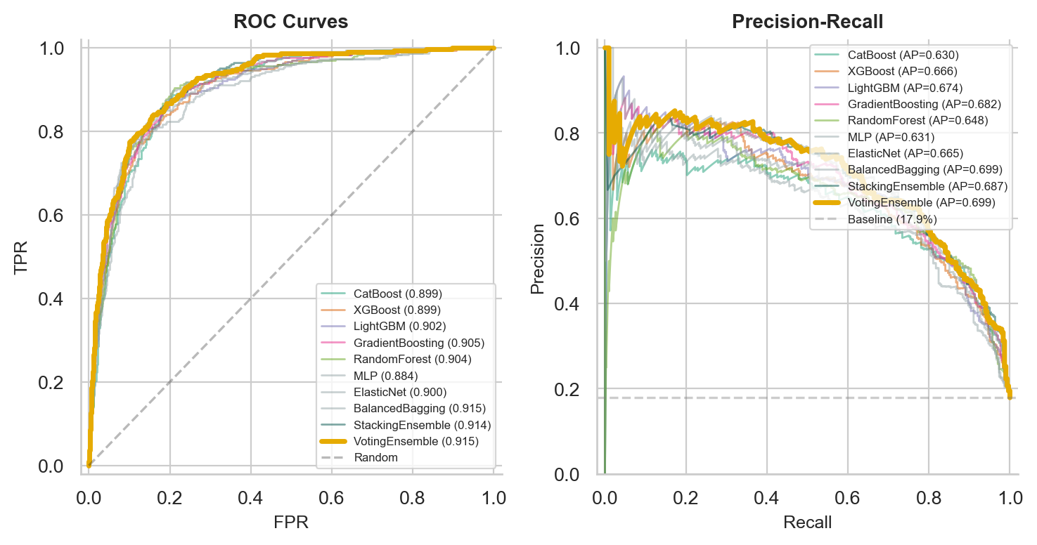
Model Evaluation Strategy Visualization Part 2

Slide 17
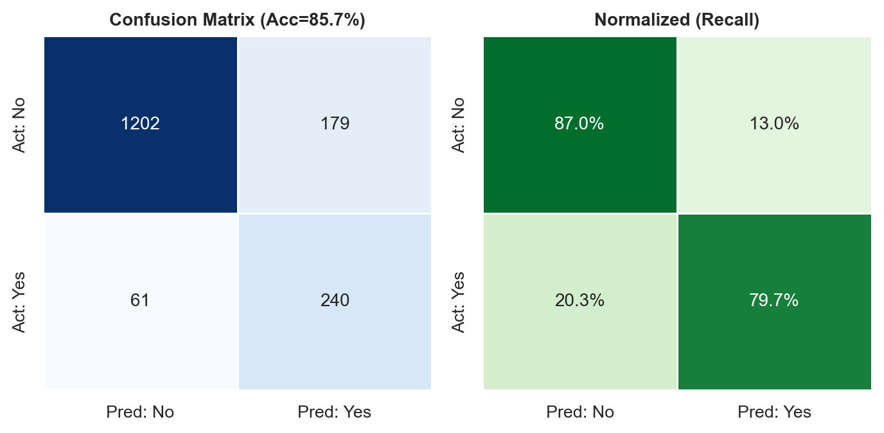
Model Evaluation Strategy Visualization Part 3

Slide 18






Model Explainability: SHAP Analysis
Senior Decision-Makers
Quality & Regulatory Roles
Premium Channels
VP, Director, and C-suite roles are the strongest conversion drivers
Highest conversion probability among all functional areas
Webinars, demos, and direct outreach significantly outperform low-value channels
High-Intent Engagement Signals
Actionable Sales Intelligence
Multiple touchpoints and recent engagement activity strongly predict conversion likelihood
Model outputs are interpretable and directly actionable, enabling SDRs to prioritize effectively
SHAP values reveal which features drive predictions, ensuring transparency and trust for sales adoption

Slide 19
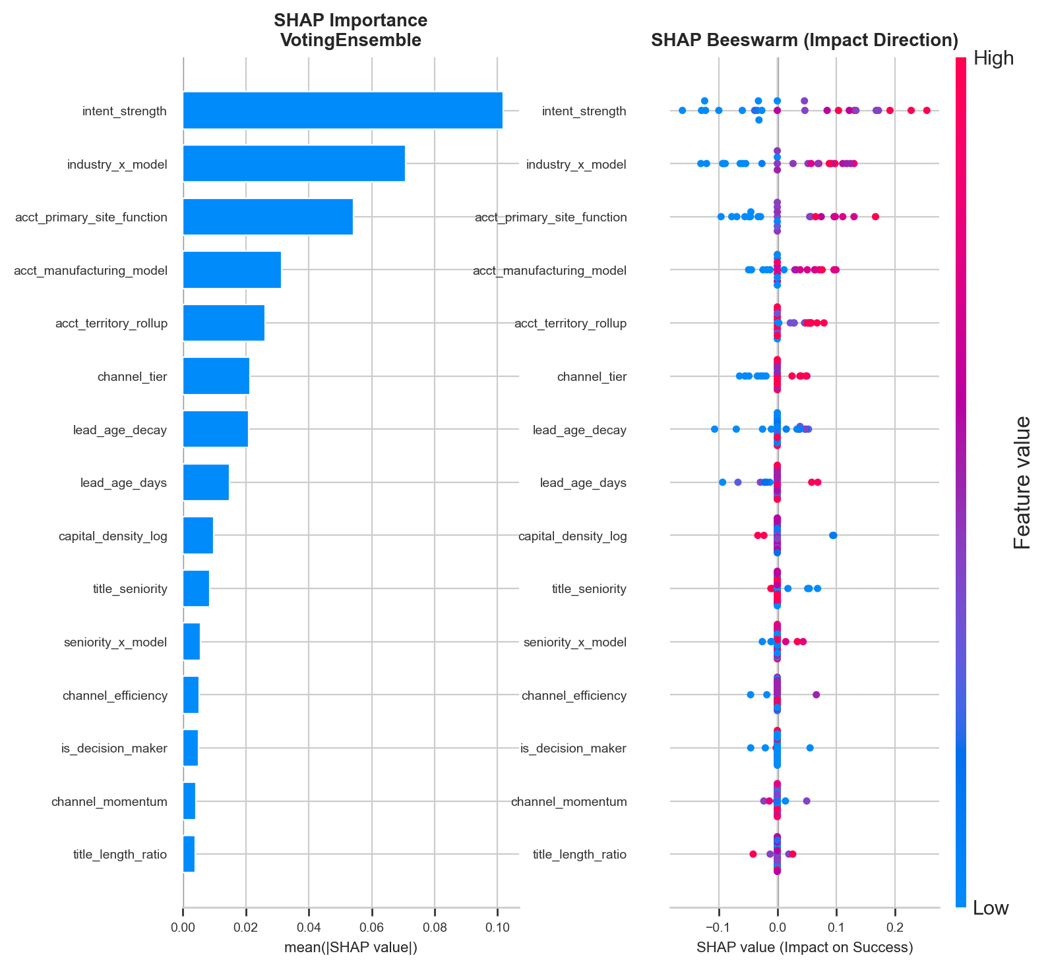
SHAP Analysis Visualization Part 1

Slide 20
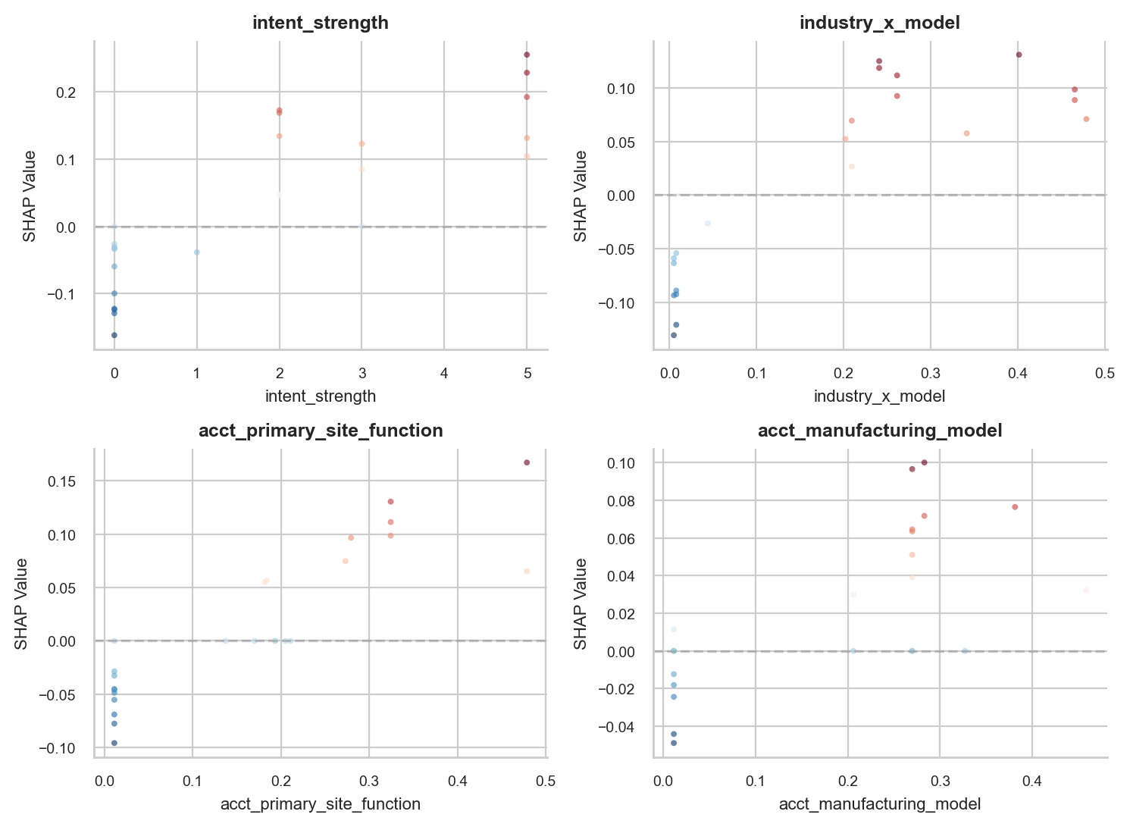
SHAP Analysis Visualization Part 2

Slide 21
Business Impact Quantification
Scoring
Model generates probability scores for all leads, ranking conversion likelihood
Strategy
Ranked lead lists enable optimal SDR contact strategy and time allocation
Selection
Profit maximization through data-driven lead selection and prioritization
Allocation
Resource allocation optimized based on conversion likelihood scores
ROI
Measurable ROI improvement through targeted outreach to high-probability leads

Slide 22
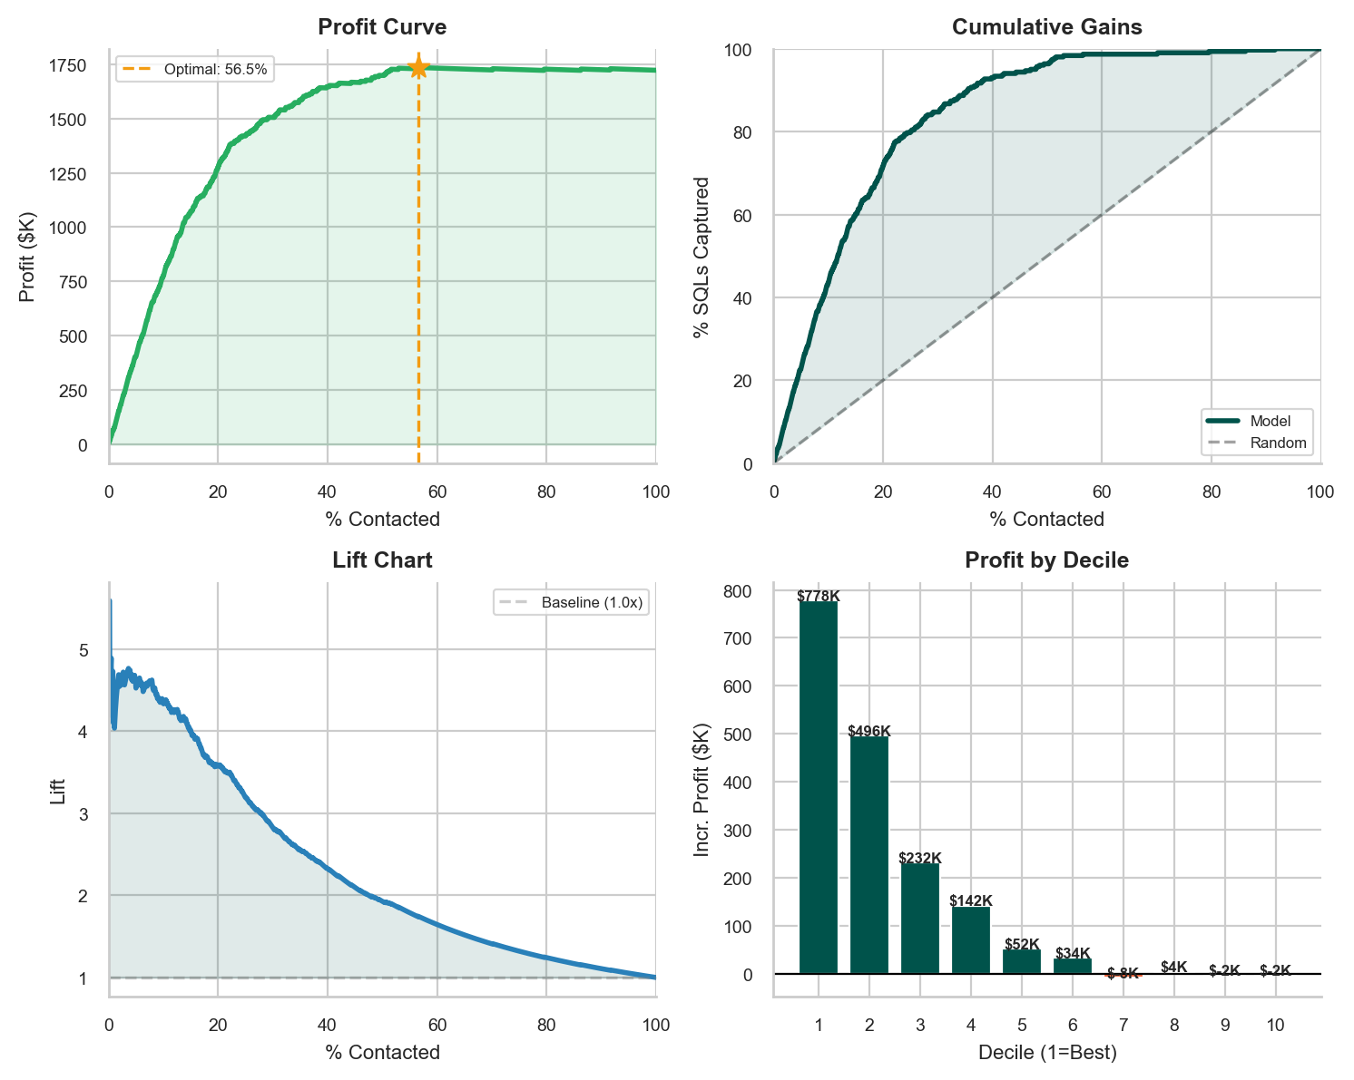
Business Impact Visualization
**Optimal Profit Configuration**
| Metric | Value |
|:------------------|:-----------|
| Optimal Threshold | 0.076 |
| Leads to Contact | 951 |
| SQLs Captured | 297 |
| % Population | 56.5% |
| SQL Capture Rate | 98.7% |
| Net Profit | $1,734,450 |
| Lift vs Random | 1.7x |

Slide 23
Class Imbalance in the Data

Slide 24
Final Model Summary KPIs
| Metric | Value |
|:------------------|:---------------|
| Test AUC-ROC | 0.9147 |
| Average Precision | 0.6993 |
| Best Model | VotingEnsemble |
| Optimal Threshold | 0.076 |
| Max Profit (Test) | $1,734,450 |
| Annual Lift | $150,600 |
| Calls Required | 951 (57%) |
| SQL Capture | 99% |
| Top Decile Conv. | 77.5% |
| Baseline Conv. | 17.9% |

Slide 25
Strategic Recommendations
Priority
Industry
Seniority
Channels
Re-engagement
Focus SDR time exclusively on top-ranked leads
Target Pharma and Biotech sectors
Engage senior decision-makers only
Invest in high-intent engagement channels
Re-engage high-scoring recycled leads
• High-probability leads
• Maximize conversion, cut wasted outreach
• Regulatory compliance need
• Quality systems; high conversion potential
• VP and Director levels
• C-suite contacts
• Budget authority holders
• Premium webinars
• Personalized demos
• Direct executive outreach
• Incremental conversion gains
• Untapped opportunities
• Cost-effective wins

Slide 26




Conclusion and Key Takeaway
Actionable Sales Intelligence
Closes the Conversion Gap
Data-driven lead scoring transforms CRM data into actionable intelligence for sales teams
Improves Mx targeting precision and closes the 7% conversion gap with Qx
Direct Revenue Impact
Scalable Framework
Delivers measurable revenue impact by connecting SDRs with the right leads at the right time
Provides a scalable framework for continuous optimization and learning as new data emerges

